Slide 1
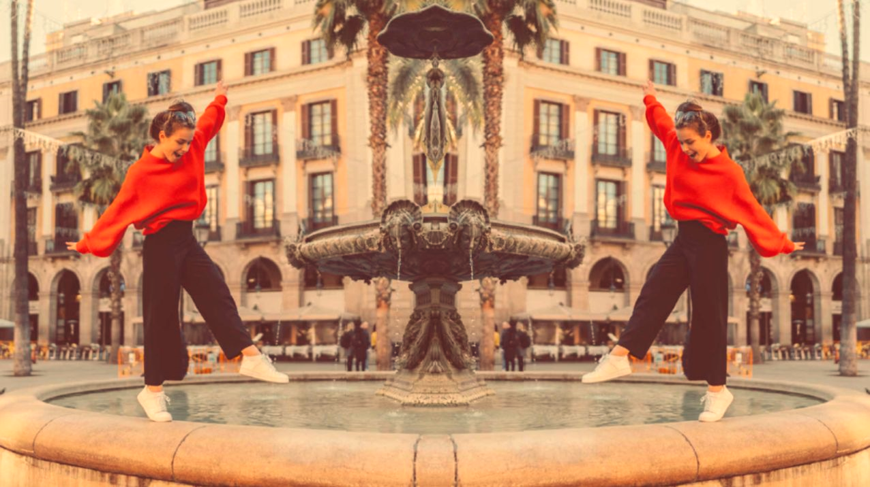
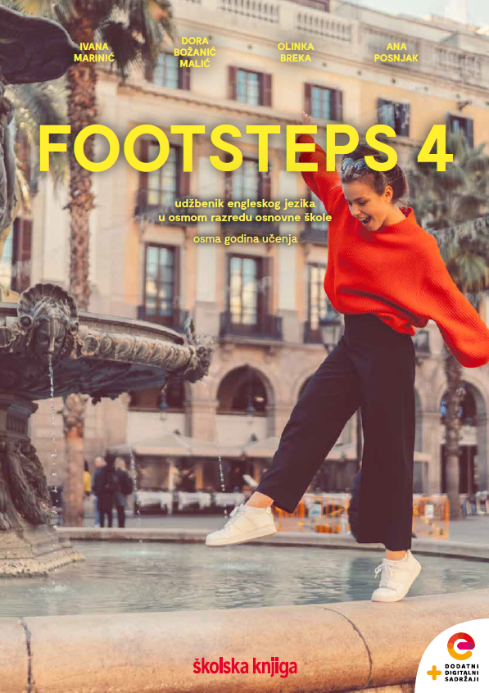

UNIT 4; All over the map
Lesson 6; Aren’t they magnificent?

Slide 2
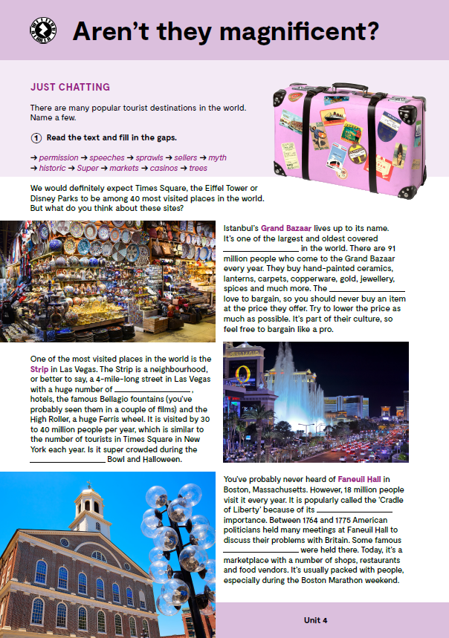
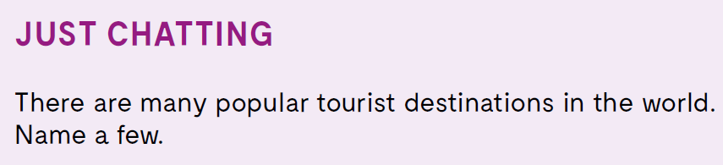
Do you know the meaning of these expressions?
marketplace
sprawl
neighbourhood
palace
fountain
botanical wonder
tržnica
proteže se
susjedstvo
palača
fontana
botaničko čudo

Slide 3

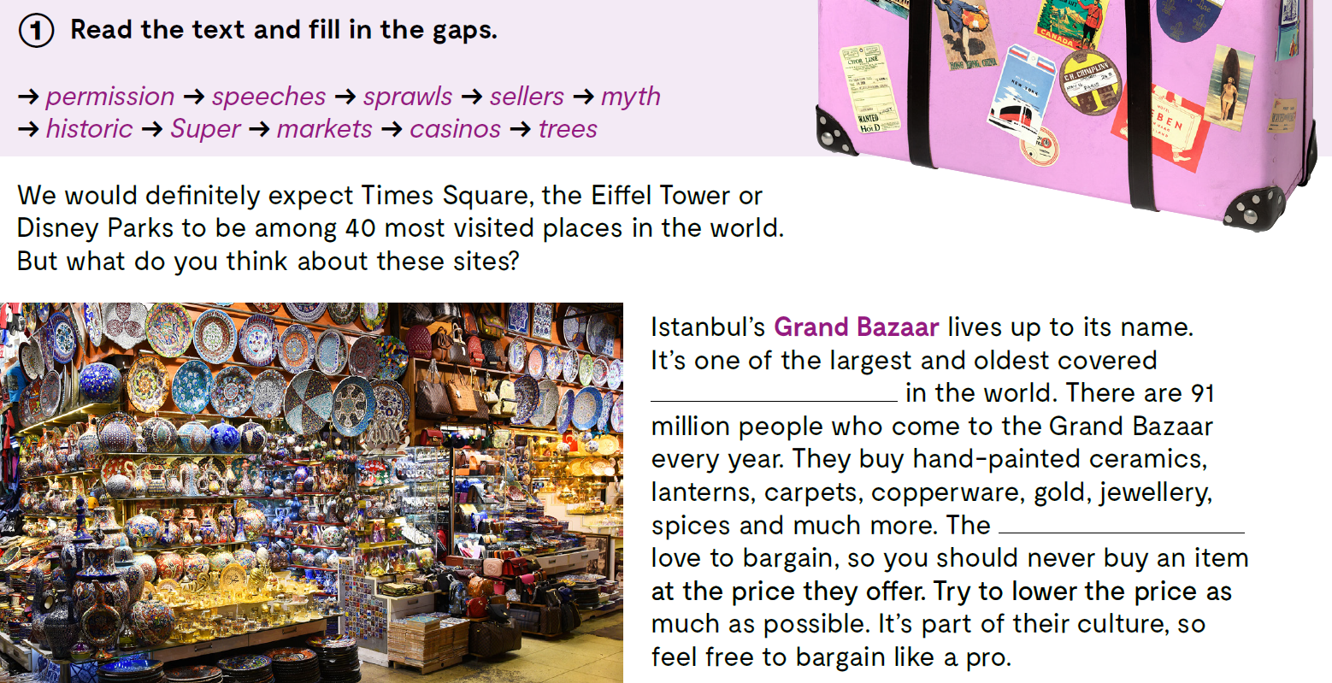
Read the text and fill in the gaps.
markets
sellers

Slide 4
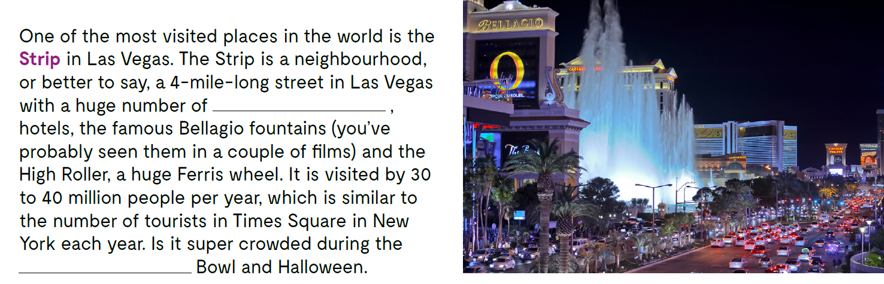
Read the text and fill in the gaps.
casinos
Super

Slide 5
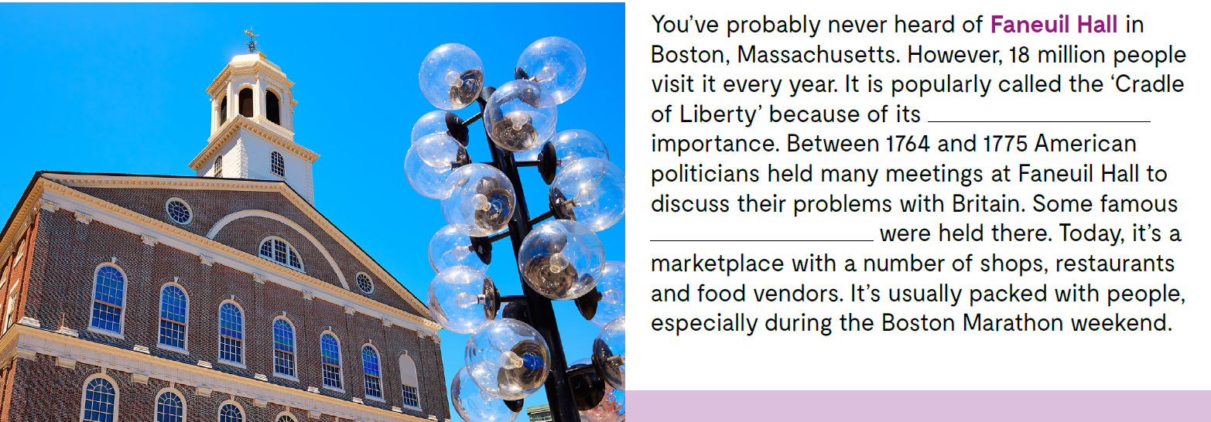
Read the text and fill in the gaps. Pročitaj tekstove o pet poznatih turističkih odredišta: Grand Bazaar u Istanbulu, the Strip u Las Vegasu, Faneuil Hall u Bostonu, the Forbidden City u Pekingu i Golden Gate Park u San Franciscu, te popuni praznine zadanim riječima: permission, speeches, sprawls, sellers, myth, historic, supermarkets, casinos, trees.
historic
speeches

Slide 6
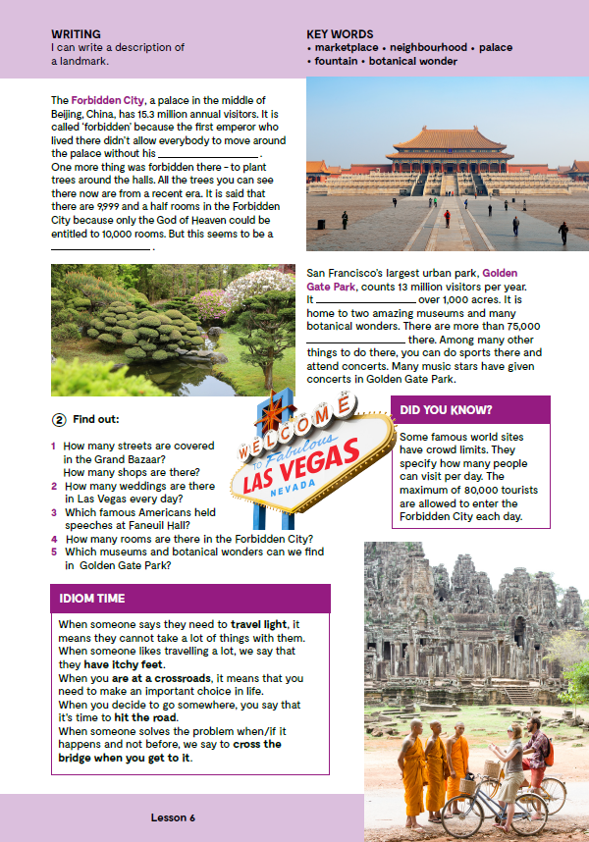
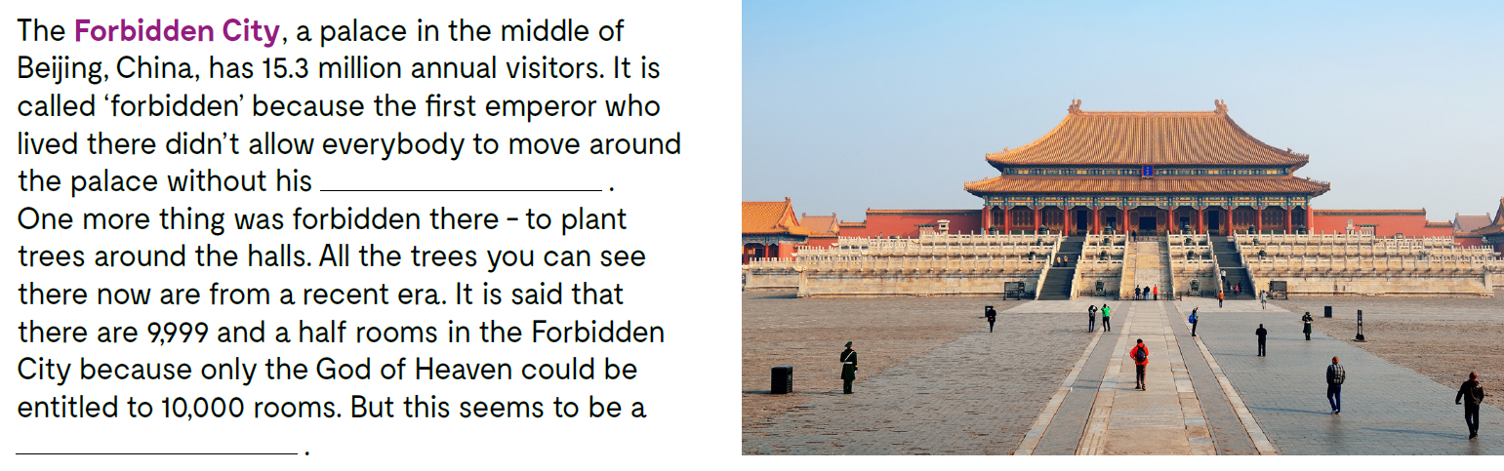
Read the text and fill in the gaps. Pročitaj tekstove o pet poznatih turističkih odredišta: Grand Bazaar u Istanbulu, the Strip u Las Vegasu, Faneuil Hall u Bostonu, the Forbidden City u Pekingu i Golden Gate Park u San Franciscu, te popuni praznine zadanim riječima: permission, speeches, sprawls, sellers, myth, historic, supermarkets, casinos, trees.
permission
myth

Slide 7
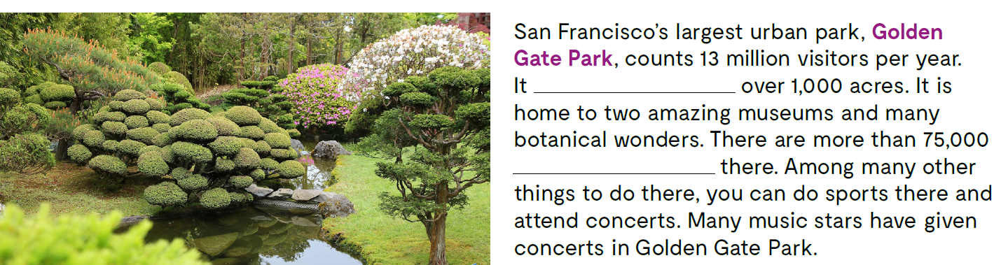
Read the text and fill in the gaps.
sprawls
trees

Slide 8
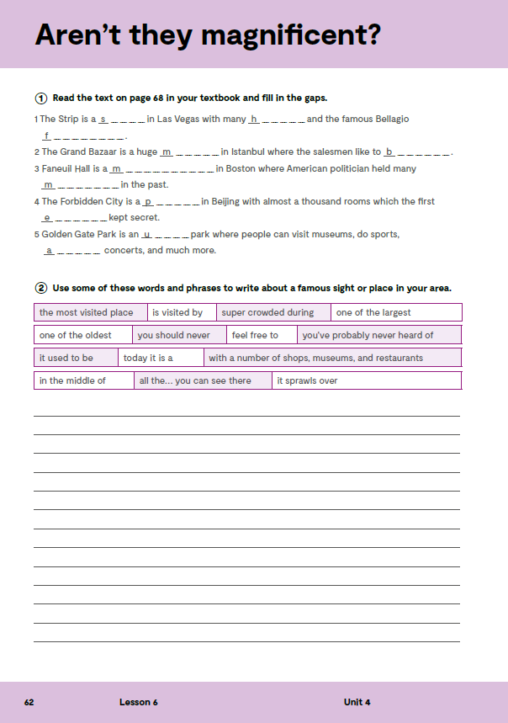
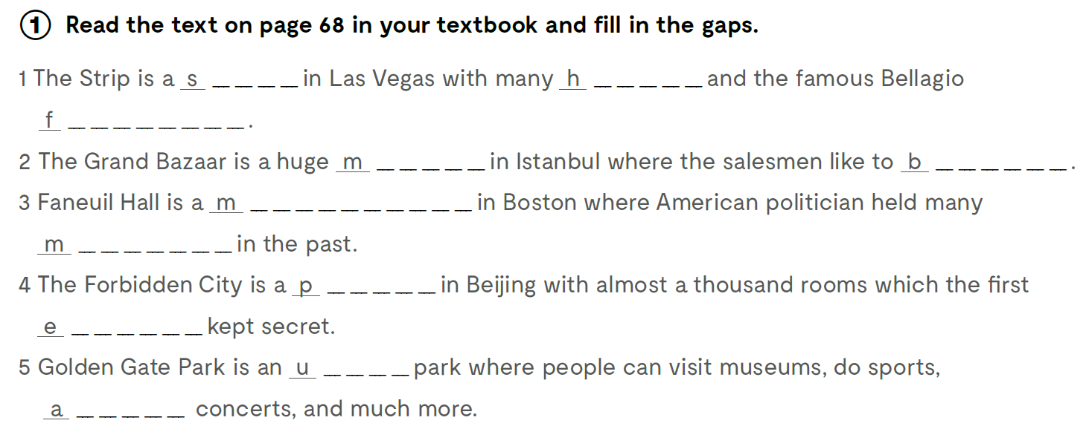
Workbook, page 62.
treet
o t e l s
o u n t a i n
a r k e t
a r g a i n
a r k e t p l a c e
e e t i n g s
a l a c e
m p e r o r
r b a n
t t e n d

Slide 9
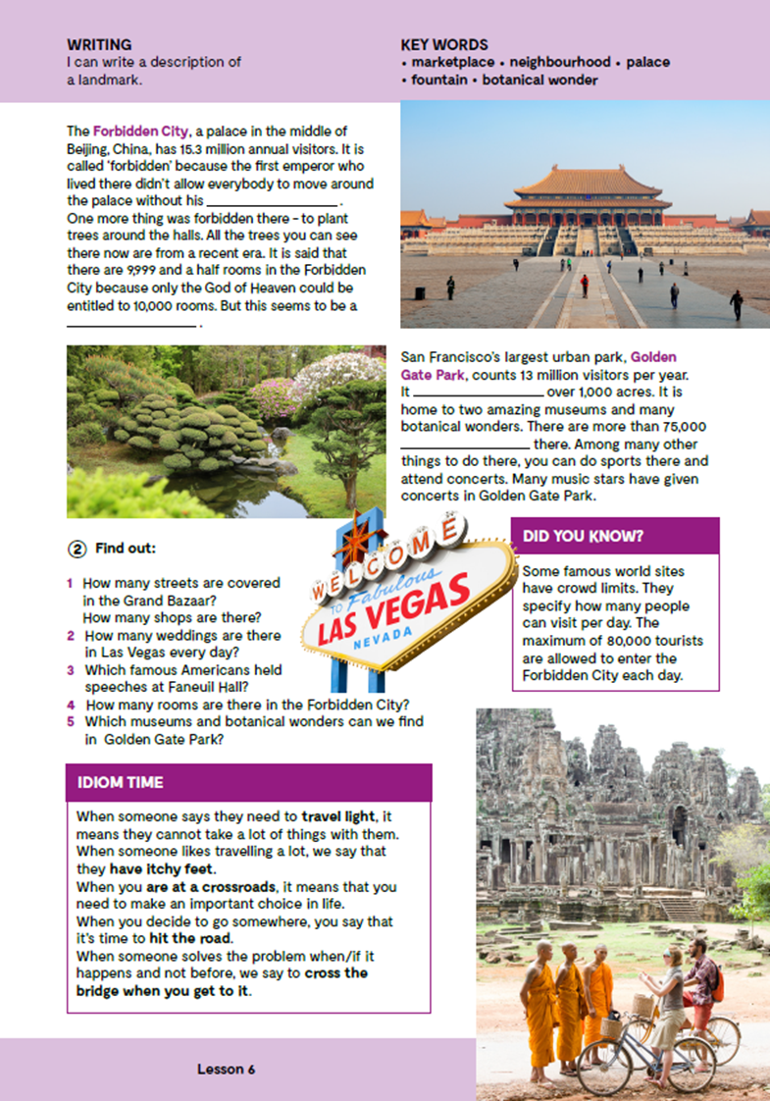
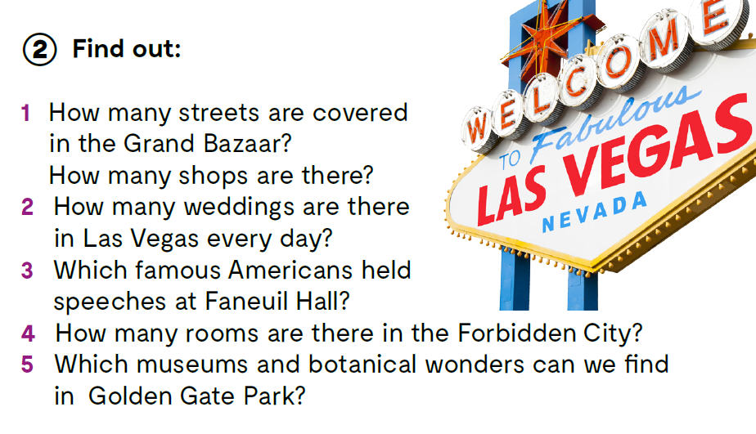

Slide 10
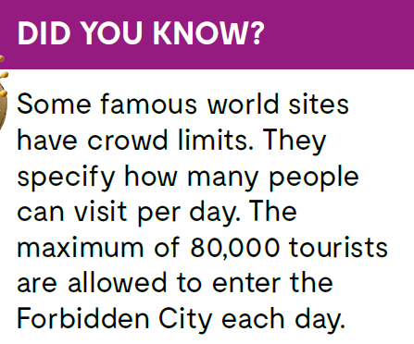
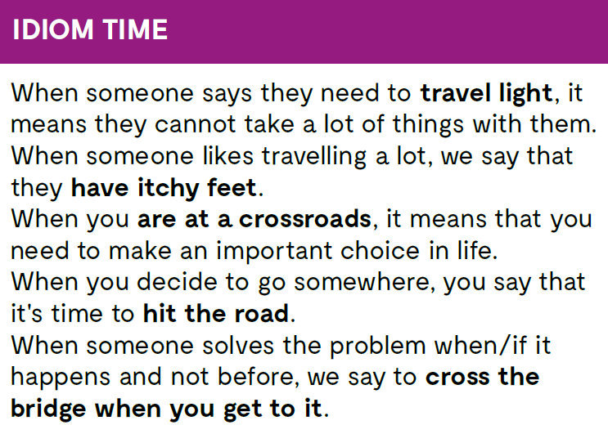
DID YOU KNOW? Some famous world sites have crowd limits. They specify how many people can visit per day. The maximum of 80,000 tourists are allowed to enter the Forbidden City each day.
Check what you have learnt. https://wordwall.net/resource/26005261
https://www.bookwidgets.com/play/UCADGUS

Slide 11
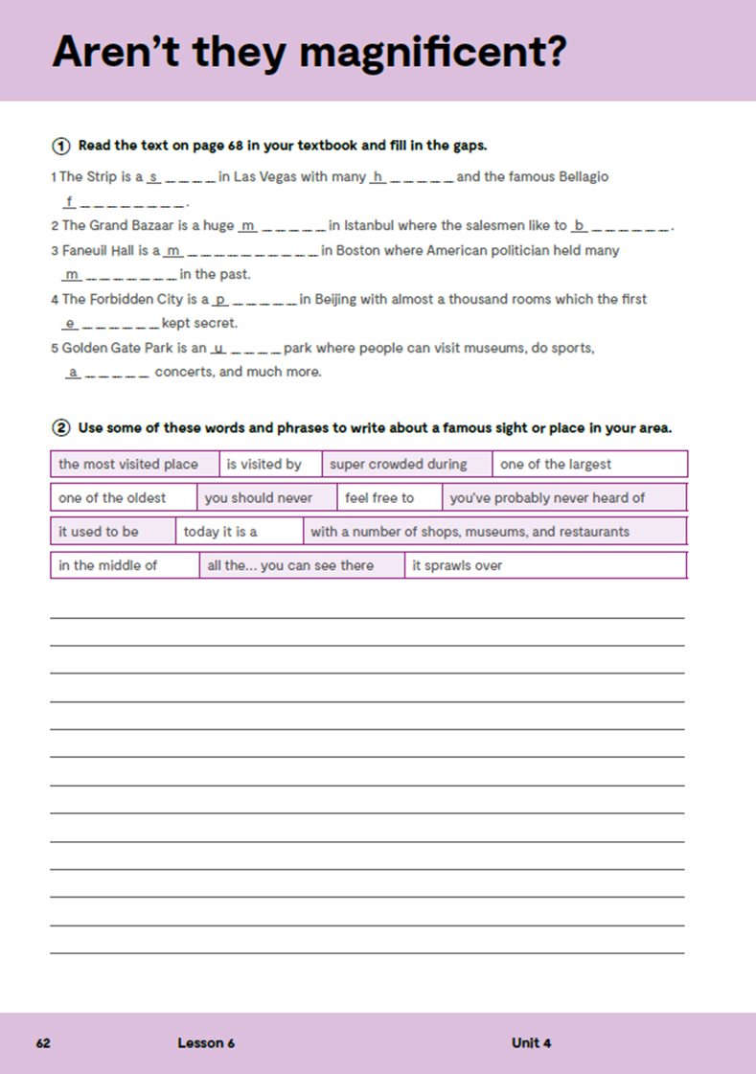
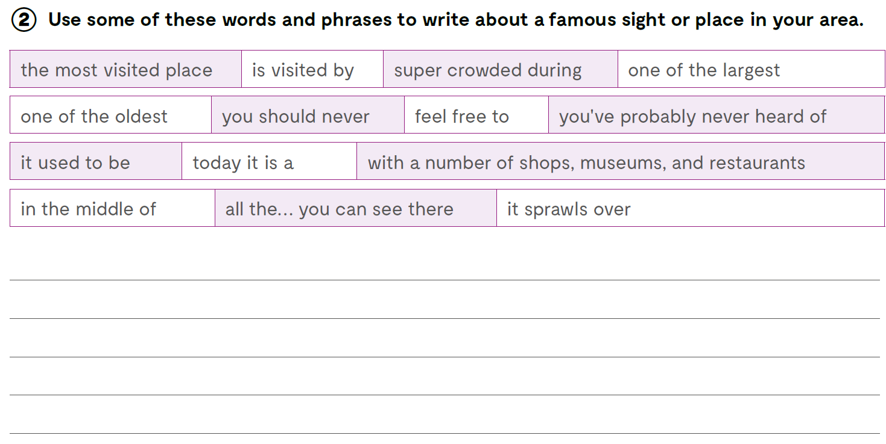
Do you know of a famous marketplace in or near Croatia?
Are there any very long and famous streets in Croatia and what can you find there?
Are there any places in Croatia comparable to the ‘Cradle of Liberty’, i.e. Faneuil Hall?
What are the largest palaces and palace complexes in and around Croatia?
Which large urban parks are there in Croatia and in its vicinity?
Workbook, page 62.
Use some of these words and phrases to write about a famous sight or place in your area.

Slide 12
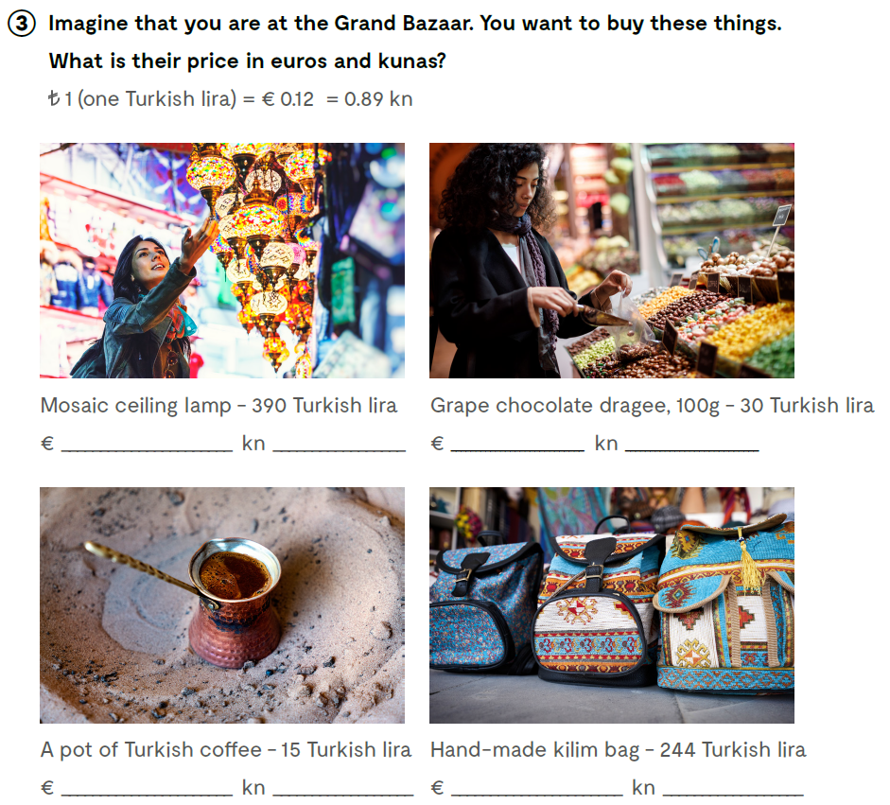
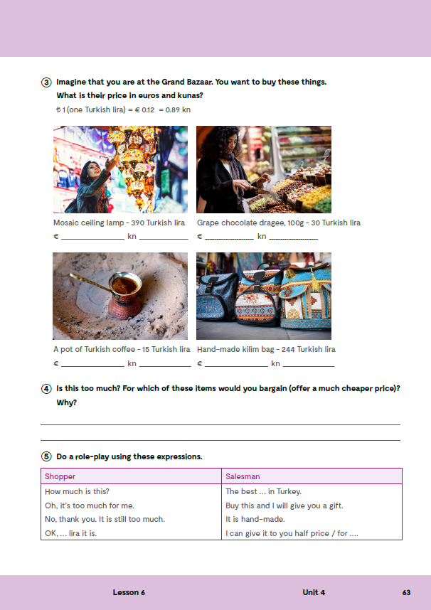
On the next page, page 63.
Imagine that you are at the Grand Bazaar. You want to buy these things. What is their price in euros and kunas?
46,80
347,10
3,60
26,70
1,80
13,35
29,28
217,16

Slide 13

